Slide 1
Which feature matters more!
Used car price prediction Model
By Morooj alqurashi

Slide 2
Table of content
Problem
Dataset
Design thinking
Read and Understand data
Data Preprocessing
EDA
Model Building
Test Assumptions

Slide 3

problem
- What are the main features that affect the price of used car?
- What is the relation between odometer & selling price?
- Should the seller trust MMR (Manheim Market Report)?
- What are the most color available in used car market
- Which state has more used car for sale?

Slide 4

dataset
The dataset is about car price in US auction.
558,811 data points
16 features .

Slide 5
Design thinking
ML model
Python Problem Features affect used car price
Libraries

Slide 6
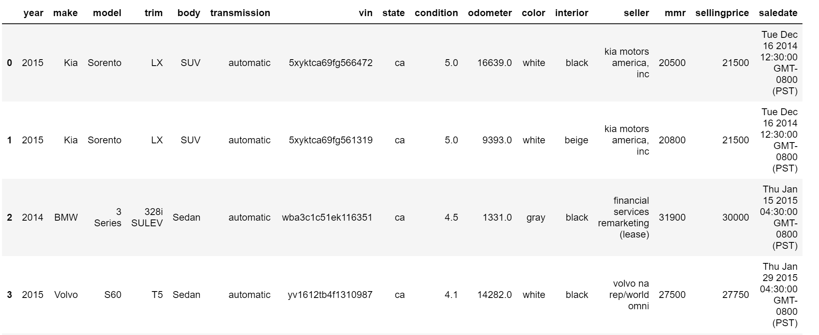
Read and Understand data

Slide 7
Data Preprocessing
Review types of columns
Check columns name
Checking for missing values
Removing the rows with missing values
Checking for duplicate rows
Deleting Irrelevant columns (trim , interior , seller)

Slide 8
EDA
observations
year of make range from 1990 to 2015
the car condition average is 3.4
tha odometer average is about 66,000 km
the mmr and sellingprice seems to be very close in statical values

Slide 9
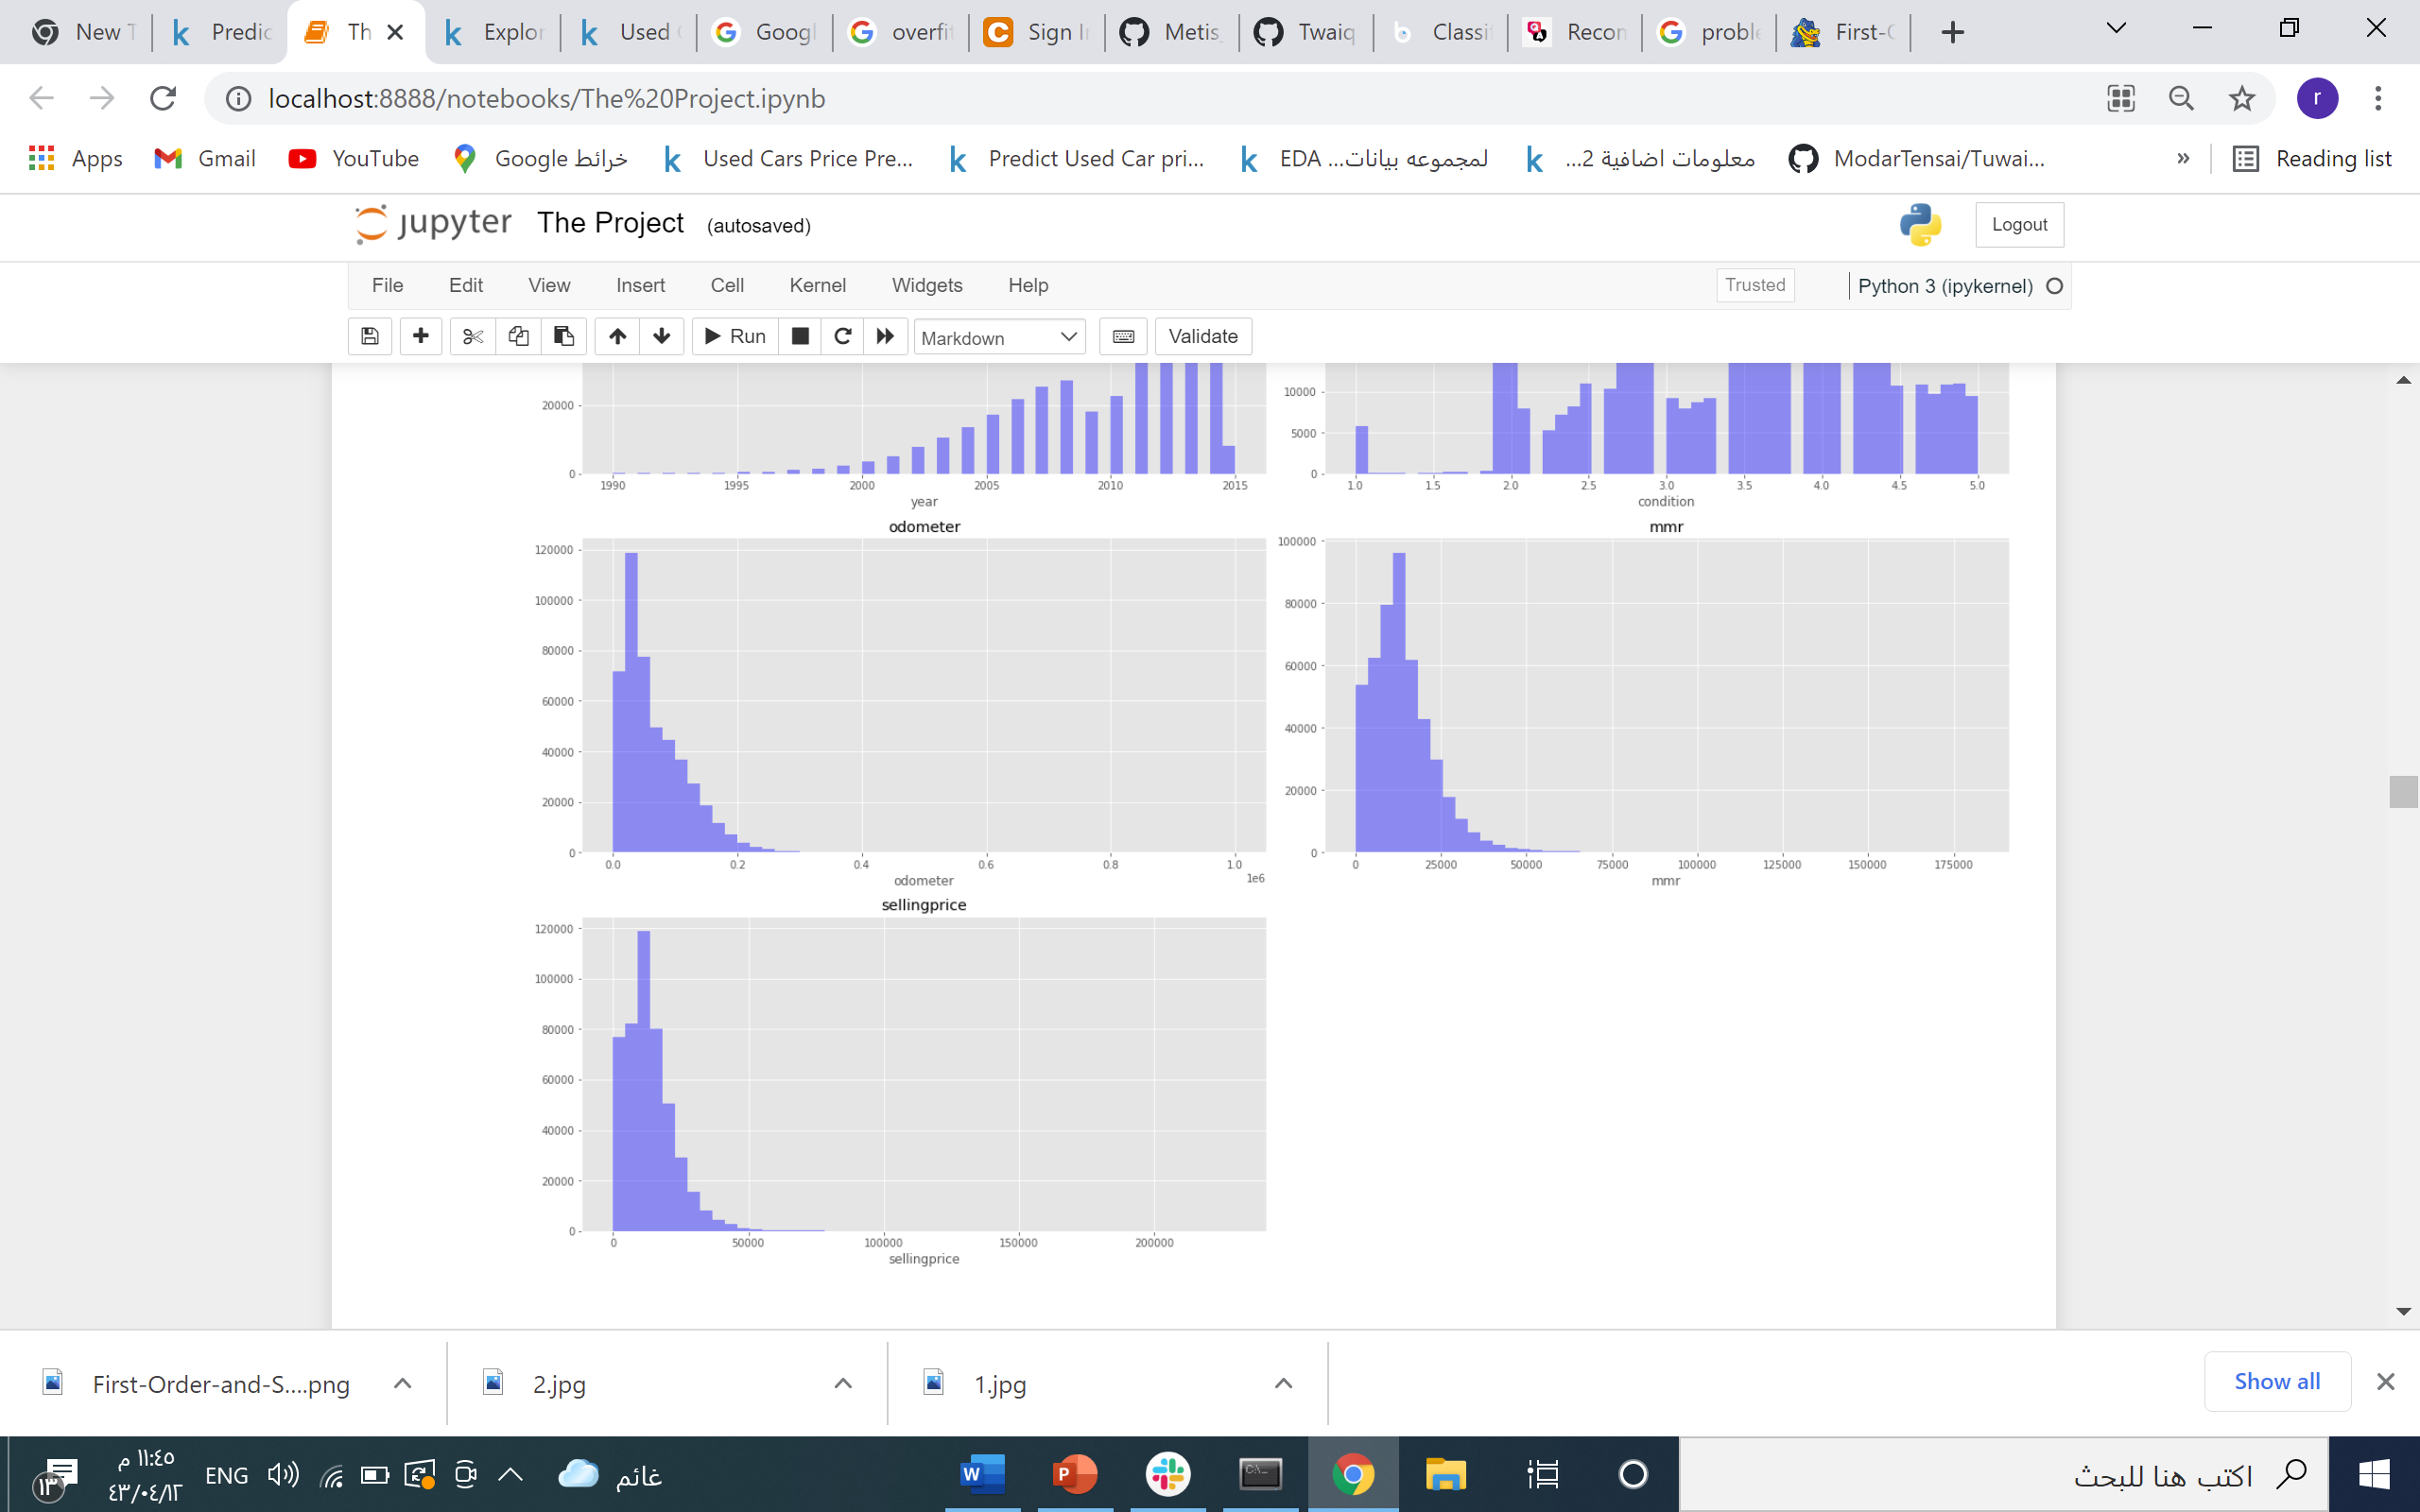
EDA – Numeric Features
Observation:
odometer has right skewed
selling price has right skewed

Slide 10
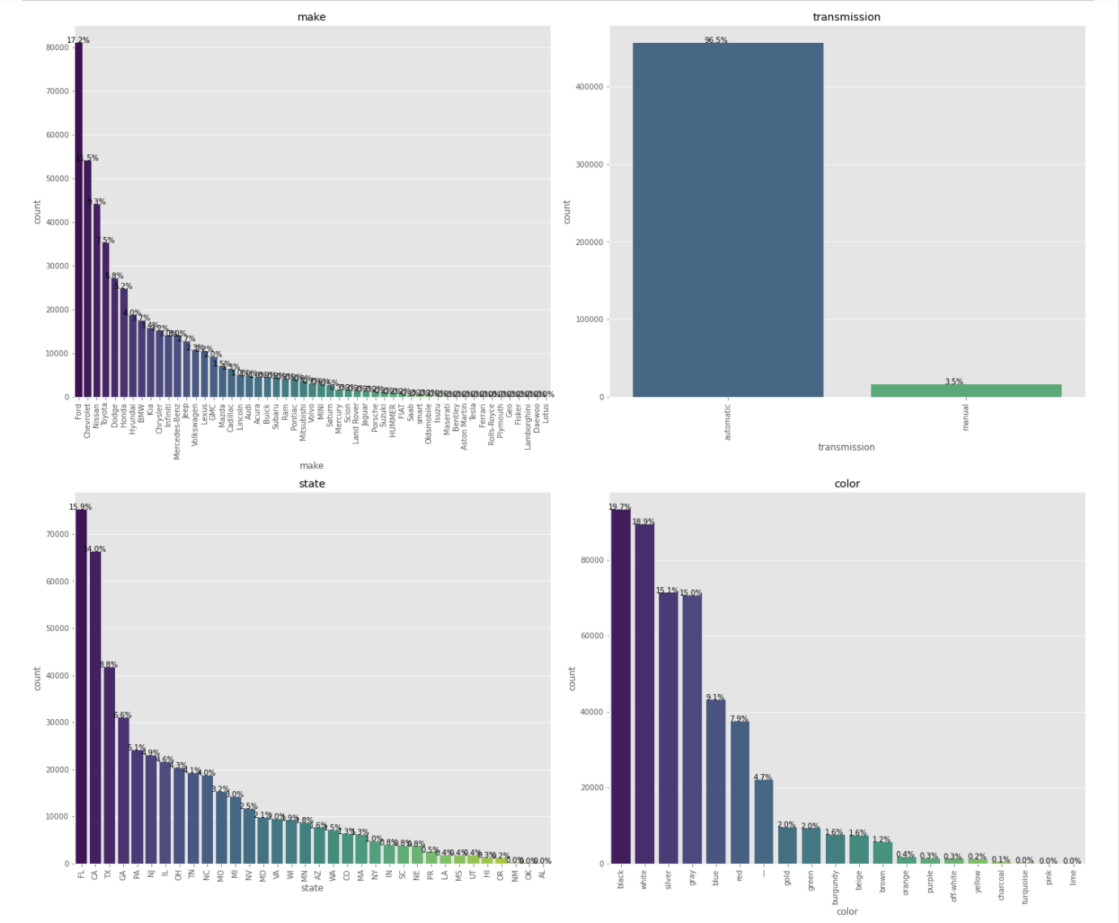
EDA- Categorical features
Observation
~97 % of the used car in the auction have manual Transmission.
~50% of the used car in the auction are one of these brand: Ford, Chevrolete, Nissan, Toyota
black, white, silver, and gray represent ~70% of the used car color in the auction
Florida, California, and Texas have highest numbers of used car availabe for purchase

Slide 11
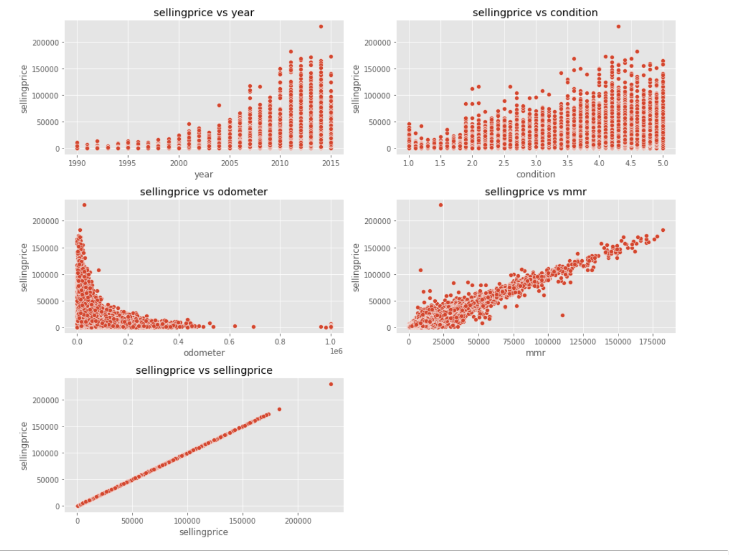
EDA- scatterplot
there is a strong correlation between the MMR and selling price .
So, MMR can be trustable since it gives the right sellingprice most of the time .
However, in this project to calculate the prediction of the used car price it is imortant to ignore the MMR as one of the feature that affect the selling price

Slide 12
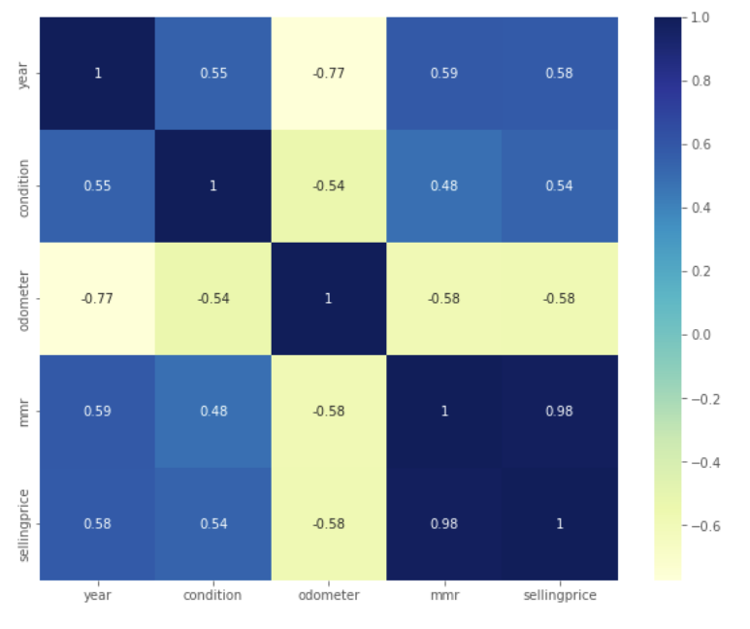
EDA-Heatmap
Observation
sellingprice has positive correlation with year of make and the condition of the car
sellingprice has negative correlation with odometer
odometer has negative correlation with condition and year of make

Slide 13
Model Building
Encode Categorical data before splitting
Split the data into train set and test set
Fit the model chosen (Linear Regression)
Check model performance

Slide 14
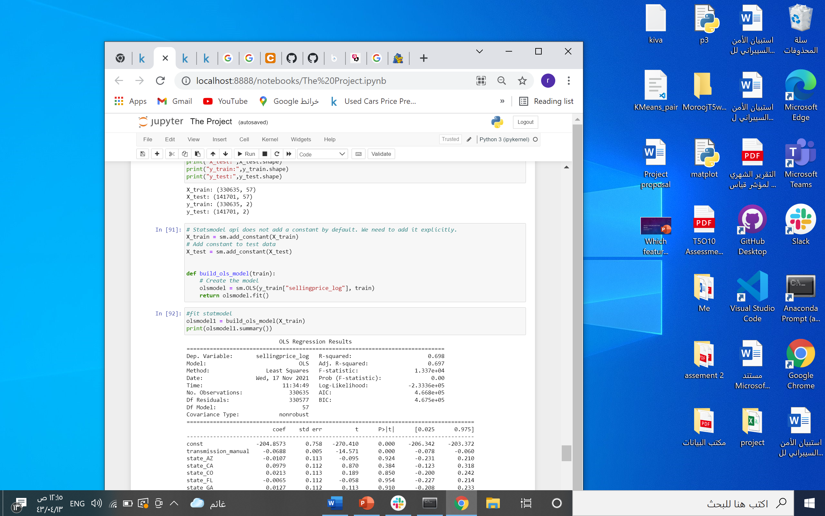
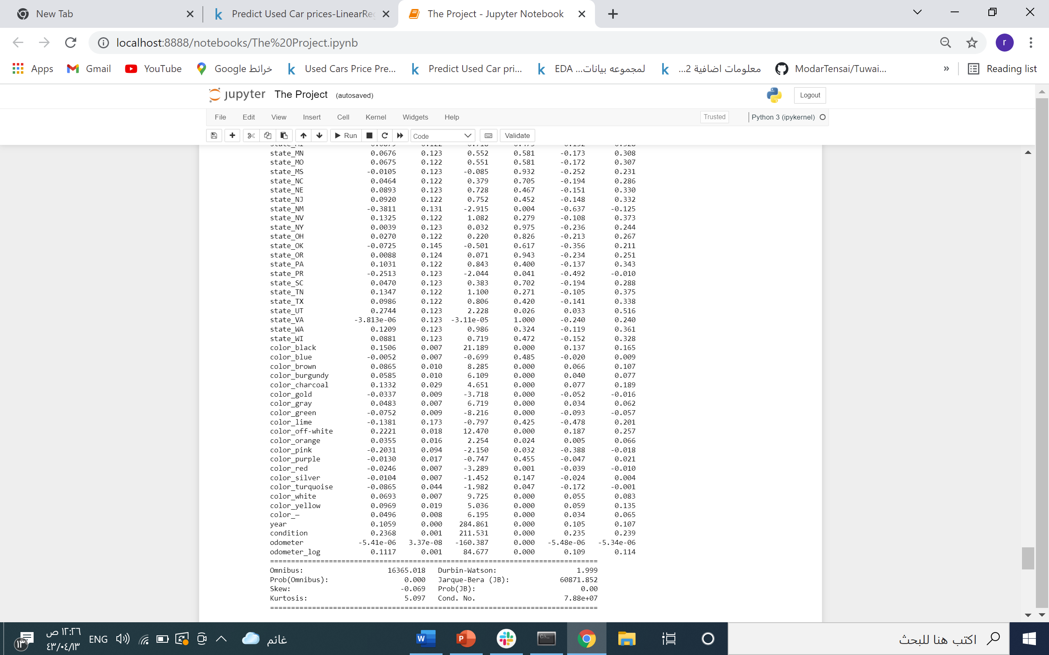

Slide 15
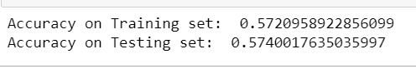
Comparing regression scores

Slide 16
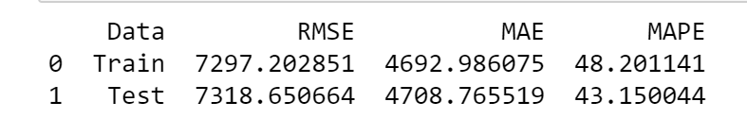
Checking model performance

Slide 17
Thank you !

